Slide 1
VISUALIZING EMPLOYEE ATTENDANCE TRENDS WITH EXCEL CHARTS
STUDENT NAME:S.RAMYA
REGISTER NO:312214572/E02399ECBF9F5FFBB0447E3B1D2BBF96
DEPARTMENT:B.COM(COMPUTER APPLICATION)
COLLEGE :ST.THOMAS COLLEGE OF ARTS AND SCIENCE

Slide 2
PROJECT TITLE
VISUALIZING EMPLOYEE ATTENDANCE TRENDS WITH EXCEL CHARTS

Slide 3


AGENDA
Problem Statement
Project Overview
End Users
Our Solution and Proposition
Dataset Description
Modelling Approach
Results and Discussion
Conclusion
3/21/2024 Annual Review

Slide 4

PROBLEM STATEMENT
In our organization, employee attendance is critical to maintaining productivity and ensuring smooth operations. However, the current approach to monitoring and analyzing attendance is primarily manual and lacks a structured, visual method for identifying trends and patterns.

Slide 5

PROJECT OVERVIEW
To automate the analysis of employee attendance data.
2) To create easy-to-understand Excel charts that visualize trends in attendance over time.
3) To provide management with actionable insights that support decision-making related to employee scheduling, leave policies, and interventions for improving attendance.

Slide 6

WHO ARE THE END USERS?
Human Resources (HR) Managers: They use attendance charts to monitor employee attendance patterns, identify issues like frequent absences or tardiness, and make data-driven decisions related to workforce management.
Department Heads or Team Leaders: They need to track attendance to manage their teams effectively, ensuring that staffing levels are adequate and addressing any concerns related to employee absences.
Operations Managers: They use attendance data to optimize scheduling, ensure that operational needs are met, and address any potential impacts on productivity due to absenteeism.
Executives or Senior Management: They use high-level attendance trends to understand overall workforce health, assess impacts on business performance, and make strategic decisions.

Slide 7

OUR SOLUTION AND ITS VALUE PROPOSITION
CONDITIONAL FORMATTING-MISSING
FILTER-REMOVE
FORMULA-PERFORMANCE
=IFS(Z8>=5,”VERYHIGH”,Z8>=4,”HIGH”,Z8>=3,”MED”,TRUE,”LOW”)
PIVOT-SUMMARY
GRAPH-DATA VISUALIZATION

Slide 8
Dataset Description
Employee= Kaggle
26- Features
9- Features
Emp Id- Number
Name Test
Emp- Type
Current Employee Rating- Number
Gender- Male Female
Employee Rating- Number

Slide 9

THE "WOW" IN OUR SOLUTION
=IFS(Z8>=5,”VERY HIGH”,Z8>=4,”HIGH”,Z8>=3,”MED”,TRUE,”LOW”)
3/21/2024 Annual Review
9

Slide 10
MODELLING
1. Prepare Your Data
Start by organizing your attendance data in Excel. Ensure your data is structured properly. A typical layout might include:
Column A: employement id(if tracking individual attendance)
Column B: first name
Column C: last name
2. Create a Summary Table
To visualize trends effectively, you should summarize your data. Create a pivot table to aggregate the data:
Select your data range (including headers).
Go to the Insert tab and select PivotTable.
Place the PivotTable in a new worksheet or existing worksheet.
In the PivotTable Field List:
Drag “employement id” to the rows area.
Drag “first name” to the columns area.
Drag “last name”(or any other countable field) to the Values area. Ensure it's set to count.
You should now have a summary table that shows attendance counts by date and status.
10

Slide 11
MODELLING
3. Insert a Chart
With the PivotTable ready, you can now create charts to visualize the trends.
Select your PivotTable (click inside it).
Go to the Insert tab and choose the type of chart that suits your data. For attendance trends, a Line Chart or Column Chart is typically useful.
Line Chart: Ideal for showing trends over time.
Column Chart: Useful for comparing different categories or dates.
After selecting the chart type, Excel will generate a chart based on your PivotTable.
4. Customize Your Chart
To make your chart more informative and visually appealing:
Add Titles: Click on the chart title to add a descriptive title, such as "Employee Attendance Trends".
Format Axis Labels: Ensure dates and attendance statuses are clearly labeled.
Add Data Labels: This helps in displaying the exact numbers on the chart.
Use Color Coding: Different colors for different attendance statuses can make trends easier to interpret.

Slide 12
MODELLING
5. Analyze Trends
Look at your chart to identify patterns:
Identify Peaks and Troughs: High and low attendance days or periods.
Compare Attendance: See if there are specific times when absences increase or if certain employees have higher absenteeism rates.
Seasonal Trends: Observe if there are seasonal or periodic patterns.

Slide 13
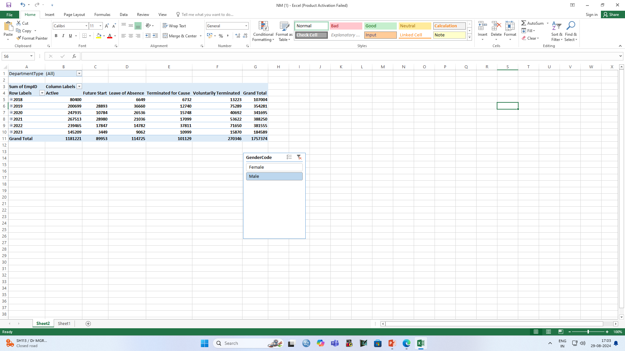
RESULT

Slide 14
RESULTS
14

Slide 15
conclusion
In conclusion, effectively visualizing employee attendance trends in Excel involves a strategic approach to data organization and presentation. By using pivot tables and dynamic charts such as line, column, and stacked column charts, you can clearly illustrate attendance patterns, compare different data points, and highlight trends over time. Enhancing these visualizations with trendlines, conditional formatting, and interactive dashboards further improves clarity and usability, enabling stakeholders to make informed decisions and identify areas needing attention. This approach not only simplifies complex data but also provides actionable insights into attendance management.

